Slide 1
Ch#06-Process Synchronization
By Dr Ahmed Awais
1
Notes:
Source: Lecture is modified from CISC3595, Spring 2015 by Dr. Zhang (Lecture is taken from this source and modified as per need)

Slide 2
Concurrency
OS supports multi-programming
In single-processor system, processes are interleaved in time
In multiple-process system, processes execution is not only interleaved, but also overlapped in time
Both are concurrent processing
Present same problems: relative speed of execution of processes cannot be predicted …
2

Slide 3
Concurrency: challenges
Present same problems: relative speed of execution of processes cannot be predicted …
Concurrent access to shared data may result in data inconsistency
E.g. two processes both make use of same global variable (in shared memory segment) and perform reads and writes
The order in which the various reads and writes are executed is critical
Challenges in resource allocation: deadlock prevention
Locating programming error is difficult: sometimes not deterministic and not reproducible
3

Slide 4
Example
Suppose processes P1, and P2 share global variable a
At some point, P1 updates a to the value 1
At some point, P2 updates a to the value 2
The two tasks are in a race to write variable a
The loser of the race (the process that updates last) determines the final value of a
This last-to-update process is sometimes humorously called the "loser" because, despite "losing" the race in terms of speed, it ends up dictating the final state.
If multiple processes or threads read and write data items so that final result depends on the order of execution of instructions in the multiple processes, we have a race condition
Race condition is bad !
Process synchronization is about how to avoid race condition
4

Slide 5

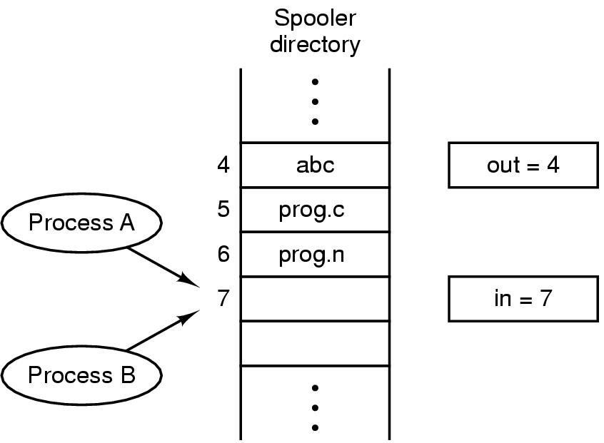
Race Conditions
Figure 2-21. Two processes want to access shared memory at the same time.
Tanenbaum, Modern Operating Systems 3 e, (c) 2008 Prentice-Hall, Inc. All rights reserved. 0-13-6006639

Slide 6
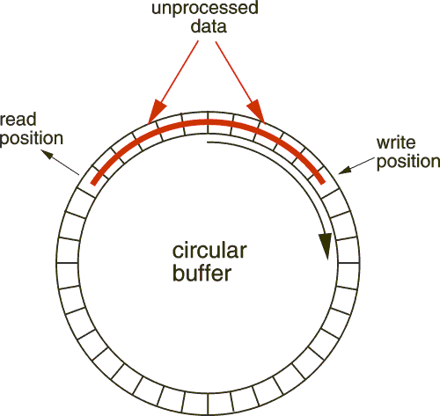
Bounded-Buffer – Shared-Memory Solution
Shared data: implemented as a circular array
#define BUFFER_SIZE 10
typedef struct {
. . . // information to be shared
} item;
item buffer[BUFFER_SIZE];
int in = 0;
int out = 0;
out
in
0
6
6

Slide 7
Example: Consumer-Producer Problem
Circular buffer
Index in: the next position to write to
Index out: the next position to read from
To check buffer full or empty:
Buffer empty: in==out
Buffer full: in+1 % BUFFER_SIZE == out
Why ? There is still one slot left …
8

Slide 8
Bounded-Buffer
Producer
out
while (true) { /* Produce an item */
while (( (in + 1) % BUFFER_SIZE) == out)
; /* do nothing -- no free buffers */
buffer[in] = newProducedItem;
in = (in + 1) % BUFFER SIZE;
}
in
while (true) {
while (in == out)
; // do nothing -- nothing to consume
// remove an item from the buffer
itemToConsume = buffer[out];
out = (out + 1) % BUFFER SIZE;
return itemToComsume;
}
Consumer
Solution is correct, but can only use BUFFER_SIZE-1 elements
7
7

Slide 9
Example: Consumer-Producer Problem
Circular buffer
Suppose that we want to use all buffer space:
an integer count: the number of filled buffers
Initially, count is set to 0.
incremented by producer after it produces a new buffer
decremented by consumer after it consumes a buffer.
9

Slide 10
Producer/Consumer
Producer
while (true) {
/* produce an item
and put in nextProduced */
while (count == BUFFER_SIZE)
; // do nothing
buffer [in] = nextProduced;
in = (in + 1) % BUFFER_SIZE;
count++;
}
Consumer
while (true) {
while (count == 0)
; // do nothing
nextConsumed = buffer[out];
out = (out + 1) % BUFFER_SIZE;
count--;
/* consume the item in
nextConsumed */
}
Is there a race condition?
10

Slide 11
Producer/Consumer
Producer
Consumer
or
Producer
Consumer

Slide 12
From C++ code to machine instructions
count++ could be implemented as register1 = count register1 = register1 + 1 count = register1
count-- could be implemented as register2 = count register2 = register2 - 1 count = register2
11

Slide 13
Race Condition if count++ and count– are interleaved
Consider this execution interleaving with “count = 5” initially:
Producer: register1 = count
Producer: register1 = register1 + 1
Consumer: register2 = count
Consumer: register2 = register2 - 1
Producer: count = register1
Consumer: count = register2
register1 = 5
register1 = 5+1=6
register2 = 5
register2 = 5-1=4
count = 6
count = 4
12

Slide 14
Race Condition
A race condition occurs when
Multiple processes access and manipulate same data concurrently
Outcome of execution depends on the particular order in which the access takes place.
Critical section/region
the segment of code where process modifying shared/common variables (tables, files)
Critical section problem, mutual exclusion problem
No two processes can execute in critical sections at the same time
13

Slide 15
Conditions required to avoid race condition
Mutual Exclusion: No two processes may be simultaneously inside their critical regions.
No assumptions may be made about speeds or the number of CPUs.
No process running outside its critical region may block other processes (progress)
Bounded Waiting: No process should have to wait forever to enter its critical region (no deadlock or starvation)
Tanenbaum, Modern Operating Systems 3 e, (c) 2008 Prentice-Hall, Inc. All rights reserved. 0-13-6006639

Slide 16
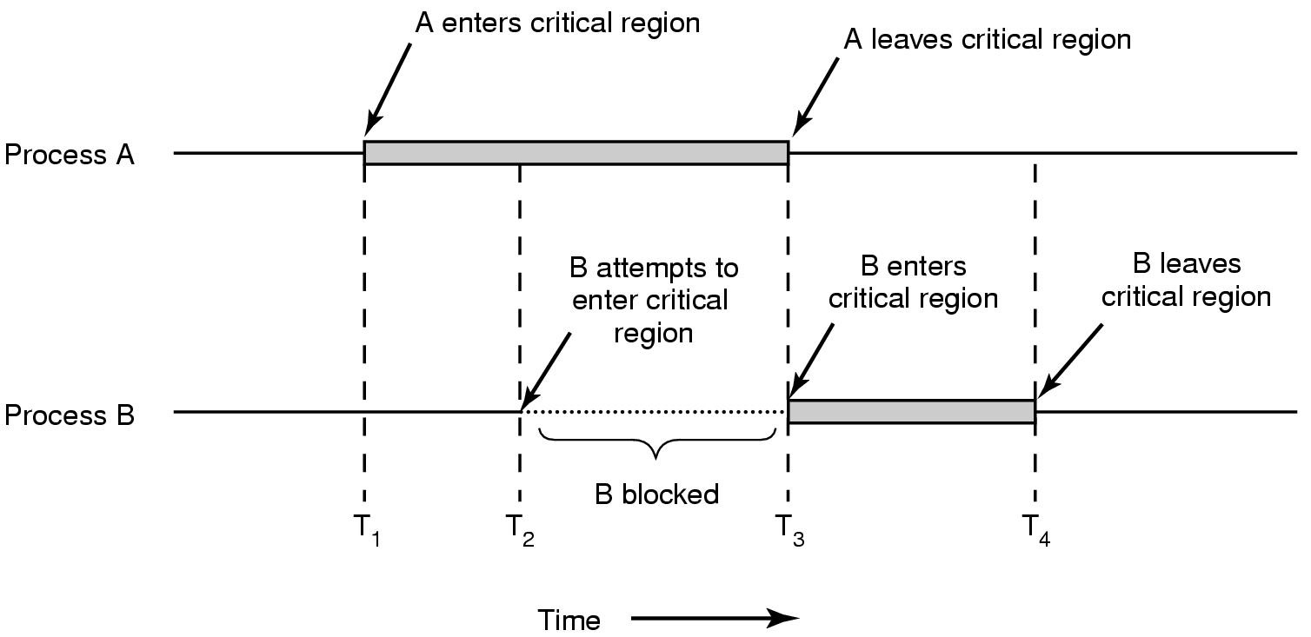
Critical Regions (2)
Figure 2-22. Mutual exclusion using critical regions.
Tanenbaum, Modern Operating Systems 3 e, (c) 2008 Prentice-Hall, Inc. All rights reserved. 0-13-6006639

Slide 17
Mutual Exclusion with Busy Waiting
Proposals for achieving mutual exclusion:
Disabling interrupts
Lock variables
Strict alternation
Peterson's solution
The TSL (Test and Set Lock) instruction
Tanenbaum, Modern Operating Systems 3 e, (c) 2008 Prentice-Hall, Inc. All rights reserved. 0-13-6006639

Slide 18
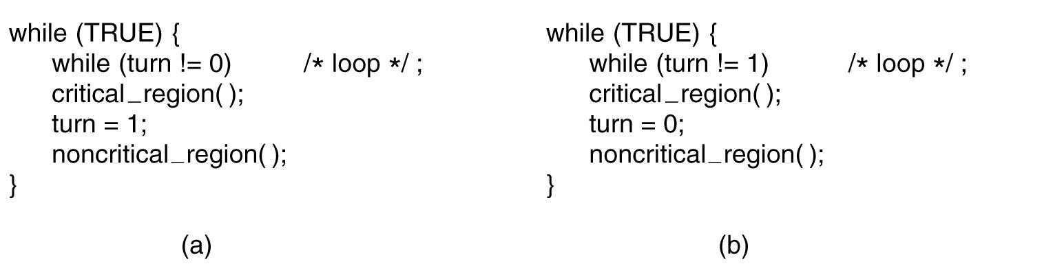
Strict Alternation
Figure 2-23. A proposed solution to the critical region problem. (a) Process 0. (b) Process 1. In both cases, be sure to note the semicolons terminating the while statements.
Tanenbaum, Modern Operating Systems 3 e, (c) 2008 Prentice-Hall, Inc. All rights reserved. 0-13-6006639

Slide 19
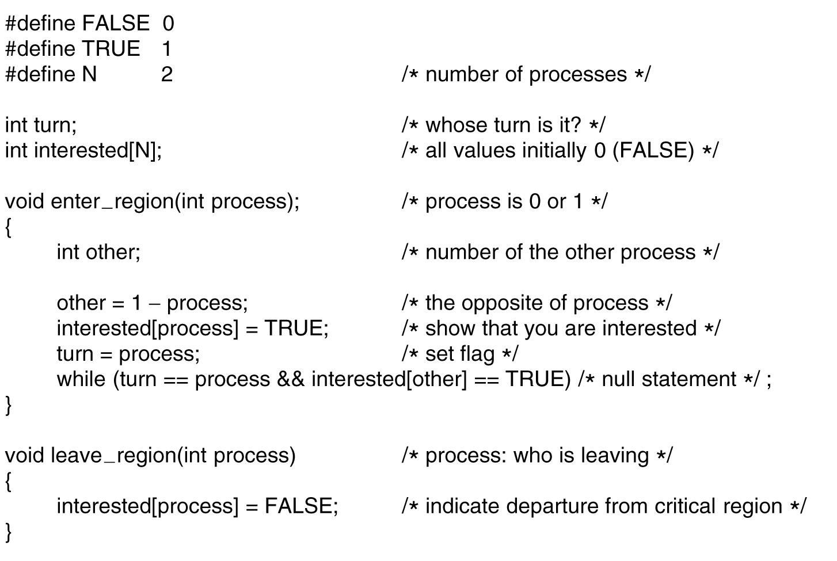
Peterson's Solution
Figure 2-24. Peterson’s solution for achieving mutual exclusion.
Tanenbaum, Modern Operating Systems 3 e, (c) 2008 Prentice-Hall, Inc. All rights reserved. 0-13-6006639

Slide 20
Critical Section Illustrated
Do {
Entry section
Critical section
Exit section
Remainder section
} while (TRUE);
14

Slide 21
Discussions
Is there a race condition ?
Child process: calculate and write Finonacci sequence to shared memory
Parent process: read contents from shared memory and display to standard output
How do you avoid this ?
16

Slide 22
Critical Section in OS Kernel
OS kernel maintains various data structures
A list (table) of all open files
Structure for memory allocation
Ready queue (queue of PCB for ready processes)
When user program issues system calls, open(), fork(),
User program traps to kernel mode => user process runs in kernel mode during system calls
Many processes in kernel modes => race condition
Nonpreemptive kernels: easy case
process running in kernel mode cannot be preempted… => bad for realtime programming
Preemptive kernel need to handle critical section
17

Slide 23
Approach to mutual exclusion
Software approach
No support from programming language or OS
Prone to high processing overhead and bugs
E.g., Peterson’s Algorithm
Hardware approach
Special-purpose machine instructions
Less overhead, machine independent
OS or programming language
18

Slide 24
Peterson’s Solution
Two processes
Accesses shared variables
Assume that LOAD and STORE instructions are atomic; that is, cannot be interrupted
i.e., read and write memory
Two shared variables deciding who enters critical section:
int turn;
indicates whose turn it is to enter critical section.
boolean flag[2]
indicate if a process wishes to enter critical section.
flag[i] = true => process P_{i} wishes to enter
19

Slide 25
Algorithm for Process P_{i} (i=0,1)
while (true) {
flag[i] = TRUE;
turn = j;
while (flag[j] && turn == j);
CRITICAL SECTION
flag[i] = FALSE;
REMAINDER SECTION
}
20

Slide 26
Analysis of Peterson’s Solution
Process P0
while (true) {
flag[0] = TRUE;
turn = 1;
while (flag[1] && turn == 1);
CRITICAL SECTION
flag[0] = FALSE;
REMAINDER SECTION
}
Process P1
while (true) {
flag[1] = TRUE;
turn = 0;
while (flag[0] && turn == 0);
CRITICAL SECTION
flag[1] = FALSE;
REMAINDER SECTION
}
Show that p0, and p1 cannot be both in critical section.
21

Slide 27
Progress and bounded waiting
If Pi cannot enter CS, then it is stuck in while() with
condition flag[ j] = true and turn = j.
1) If Pj is not ready to enter CS, then flag[ j] = false and Pi can then enter its CS (Progress)
2) Otherwise, if Pj has set flag[ j]=true and is in its while(), then either turn=i or turn=j
If turn=i, then Pi enters CS.
If turn=j then Pj enters CS but will then reset
flag[j]=false on exit: allowing Pi to enter CS
but if Pj has time to reset flag[ j]=true, it must also set turn=i
since Pi does not change value of turn while stuck in while(), Pi will enter CS after at most one CS entry by Pj (bounded waiting)
22

Slide 28
Peterson’s Solution
Purely software based solution
Might failed for modern computer architecture
Instruction reordering
Complier optimization
23

Slide 29
Hardware Solution
Many systems provide hardware support for critical section code
One approach
simply disable interrupts just before enters critical section
enable interrupts just before exits critical section
code within critical section would execute without preemption
Problems
On multiprocessor systems, need to disable interrupts on all processors => too efficient
What if a process spends a long time or forever in critical section?
Should be extremely careful when using this approach
25

Slide 30
Hardware Solution
Modern machines provide special atomic hardware instructions
atomic: non-interruptable
If there are executed simultaneously (each on a diff. CPU), they will be executed sequentially in some arbitrary order.
Two type of atomic hardware instructions
test memory word and set value, TestAndSet()
swap contents of two memory words, Swap()
26

Slide 31
TestAndSet Instruction
Definition (not implementation !):
boolean TestAndSet (boolean *target)
{
boolean rv = *target;
*target = TRUE;
return rv:
}
return target’s current value, and set target’s value to TRUE
27

Slide 32
Mutual Exclusion using TestAndSet
Shared boolean variable lock
False: no process is in critical section
True: one process is in critical section
Solution:
while (true) {
while (TestAndSet (&lock ))
; /* do nothing
//critical section
lock = FALSE;
//remainder section
}
boolean TestAndSet (boolean *target)
{
boolean rv = *target;
*target = TRUE;
return rv:
}
Does this solution satisfy mutual exclusion,
progression, bounded waiting?
28

Slide 33
Swap Instruction
An atomic instruction
Definition
void Swap (boolean *a, boolean *b)
{
boolean temp = *a;
*a = *b;
*b = temp:
}
29

Slide 34
Mutual Exclusion using Swap
Shared Boolean variable lock initialized to FALSE
Each process has a local Boolean variable key
while (true) {
key = TRUE;
while ( key == TRUE)
Swap (&lock, &key );
// critical section
lock = FALSE;
// remainder section
}
void Swap (boolean *a, boolean *b)
{
boolean temp = *a;
*a = *b;
*b = temp:
}
Does this solution satisfy mutual exclusion, progression,
Bounded waiting ?
30

Slide 35
Bounded-waiting mutual exclusion: n processes case
//find one process waiting …
j=(i+1) %n;
while ((j!=i) && !waiting[j])
j=(j+1)%n;
If (j==i) // no one is waiting,
// open the lock
lock=false;
else //j is waiting, let j access
waiting[j]=false;
//remainder section
} while (true);
Common data structure:
boolean waiting[n];
boolean lock;
Process Pi
do {
waiting[i] = true;
key=true;
while(waiting[i] && key)
key = TestAndSet(&lock);
waiting[i]=false;
//critical section
31

Slide 36
Summary: Machine-instruction approach
Applicable to single processor or multiple processors system
Simple and easy to verify
Can support multiple critical section
Each guarded by its own variable (lock)
Busy waiting is used
Potential Issues
Starvation
Deadlock
32

Slide 37
OS and Programming Language Approach
Semaphore
Mutex
Condition variables
Monitor
Event flags
Mailboxes/Messages: block send/receive…
Spinlocks
…
Fundamentally, multiple processes can cooperate (synchronize) through simple signals:
A process can be forced to stop at a specific location until it receives a specific signal
33

Slide 38
Semaphore
A semaphore is a synchronization mechanism used in operating systems and concurrent programming to manage access to shared resources. It helps prevent race conditions and ensures mutual exclusion in multi-threaded environments.
Semaphore S – integer variable
Can only be accessed via two indivisible (atomic) operations
wait() and signal(), originally called P() and V() respectively
wait (S) {
while (S <= 0)
; // do nothing while (S<=0)
S--;
}
signal (S) {
S++;
}
Spinlock
34

Slide 39
Semaphore
The P() and V() operations were originally introduced by Dutch computer scientist Edsger Dijkstra in the context of semaphores.
Meaning of P() and V():
P() (Proberen – "To Try" in Dutch) → Represents the wait() operation, meaning a process is trying to acquire the semaphore.
V() (Verhogen – "To Increase" in Dutch) → Represents the signal() operation, meaning a process releases the semaphore, incrementing its value.
How It Works:
P(S) (wait operation) → Decrements S and blocks if S ≤ 0.
V(S) (signal operation) → Increments S, allowing blocked processes to proceed.

Slide 40
Real-World Example Traffic Light at a One-Lane Bridge
Imagine a one-lane bridge where only one car can pass at a time.
The traffic light acts like a semaphore.
When a car reaches the bridge, it performs a P() operation (wait) → if the light is red, the car stops.
When the bridge is free, the light turns green, allowing a car to V() operation (signal) → the car moves forward.
This ensures that multiple cars don’t enter the bridge simultaneously, preventing collisions.
This is exactly how semaphores control access to shared resources in programming!

Slide 41

Semaphore marine alphabet
1 : an apparatus for visual signaling (as by the position of one or more movable arms) 2 : a system of visual signaling by two flags held one in each hand
Signal
an act, event, or watchword that has been agreed on as the occasion of concerted action
something that conveys notice or warning
Notes:
Semaphore Alphabet | 2nd Renfrew Trinity https://www.2ndrenfrewtrinityscoutgroup.org.uk/about-us/our-history/flags-colours/semaphore-alphabet

Slide 42
Semaphore as General Synchronization Tool
Binary semaphore – integer value can range only between 0 and 1; can be simpler to implement
Also known as mutex (mutual-exclusive) locks
mutual exclusion using binary semaphore
Semaphore S; // initialized to 1
wait (S);
Critical Section
signal (S);
Remainder Section;
How about other requirements: progress, bounded waiting?
36

Slide 43
Semaphore as General Synchronization Tool
Binary semaphore – integer value can range only between 0 and 1; can be simpler to implement
Counting semaphore – integer value can range over an unrestricted domain
Typically initialized to the number of free resources.
Processes/Threads:
Signal(s) when resources are added
Wait(s) when resources are removed.
When value becomes zero, no more resources are present. Process that try to decrement semaphore is block until value becomes greater than zero.
Let’s see the usage of counting semaphore with an example.
37

Slide 44
Case Studies: Synchronization
Consider the Fibanocci sequence problem
Suppose the shared memory can only store 10 integers
And we want to calculate and display 100 numbers in the sequence…
Goal:
Parent reads from buffer and displays a number if there is new number in buffer
Use a counting semaphore to denote the numbers of unconsumed items in the buffer
Child generate new number if there is space in buffer
Use a counting semaphore to denote the number of free space in buffer
38

Slide 45
Implementing Couting Semaphore
record S { integer val initially K, // value of S or # of processes waiting on S // (when negative) BinarySemaphore wait initially 0, // wait here to wait on S BinarySemaphore mutex initially 1 // protects val }
P(S) { <-wait() P( S.mutex ); if (S.val <= 0) then {
S.val = S.val - 1; V( S.mutex ); P( S.wait ); } else {
S.val := S.val - 1; V( S.mutex ); } }
V(S) { <-signal() P( S.mutex ); if (S.val < 0) then V( S.wait ); S.val = S.val + 1; V( S.mutex ); }

Slide 46
Semaphore with no Busy waiting
Each semaphore has a waiting queue, with each record has:
value (of type integer): process id
pointer to next record in the queue
Two operations for manipulate waiting queue
block – place process invoking the operation on waiting queue of the semaphore
wakeup – remove one of processes in waiting queue and place it in ready queue
40

Slide 47
Semaphore with no Busy waiting
Implementation of wait:
wait (S) {
value--;
if (value < 0) {
//add this process to waiting queue
block();
}
}
Implementation of signal:
Signal (S){
value++;
if (value <= 0) {
remove a process P from the waiting queue
wakeup(P);
}
}
41

Slide 48
Semaphore Implementation
Must guarantee that no two processes can execute wait () and signal () on same semaphore at same time
Thus, implementation becomes critical section problem:
wait and signal code are placed in critical section.
ok to use busy waiting to implement this critical section:
implementation code is short
little busy waiting if critical section rarely occupied
Busy waiting not a good solution for applications that spend lots of time in critical sections
Lots of busy waiting
42

Slide 49
We will study some classical synchronization problems next …
to get ready, let’s see traps we should avoid …

Slide 50
Deadlock
Deadlock – two or more processes are waiting indefinitely for an event that can be caused by only one of waiting processes
Event: resource acquisition and release (including semaphore)
Example: let S and Q be two semaphores initialized to 1
P₀ P₁
wait (S); wait (Q);
wait (Q); wait (S);
. .
. .
. .
signal (S); signal (Q);
signal (Q); signal (S);
44

Slide 51
Starvation
Starvation: the indefinite blocking of a process
Process starvation can be due to CPU scheduling algorithm
E.g., priority scheduling
Critical section related starvation
if a process is never removed from semaphore queue in which it is suspended, e.g. if semaphore waiting queue is served in LIFO (Last-in, first-out) order
45

Slide 52
Classical Problems of Synchronization
Bounded-Buffer Problem
Readers and Writers Problem
Dining-Philosophers Problem
46

Slide 53
Case Studies: Synchronization
Consider the Fibanocci sequence problem
Suppose the shared memory can only store 10 integers
And we want to calculate and display 100 numbers in the sequence…
It’s a bounded buffer problem!
47

Slide 54
Bounded-Buffer Problem
Producer and consumer shared data
N buffers, each can hold one item
Semaphore mutex initialized to the value 1
To protect access to buffer
Semaphore full initialized to the value 0
To signal that the buffer has some item
Semaphore empty initialized to the value N
To signal that the buffer has space to hold item
48

Slide 55
Bounded Buffer Problem: Producer
while (true) { // produce an item
wait (empty); // wait for some space
wait (mutex); // get access to buffer
// add the item to the buffer
signal (mutex); // release access to buffer
signal (full); //allow processes waiting on full, i.e.,
// a consumer, to run
}
49

Slide 56
Bounded Buffer Problem: Consumer
while (true) {
wait (full); // wait for some item to consume
wait (mutex); // get access to buffer
// remove an item from buffer
signal (mutex); // release access to buffer
signal (empty); //signal producer waiting for space
// consume the removed item
}
50

Slide 57
Readers-Writers Problem
a number of concurrent processes share a data set
Readers: only read data set, do NOT perform updates
Writers: can read and write the data set.
Goal:
allow multiple readers to read at same time
while only one writer can access shared data at same time
Detailed requirements:
When multiple processes waiting to access
priority given to reader: first readers-writers problem
Priority given to writer: second readers-writers problem
51

Slide 58
First Readers-Writers Problem
Requirement:
No reader should wait for other readers to finish simply because a writer is ready (waiting too)
Shared Data
Data set
Semaphore mutex initialized to 1.
Semaphore wrt initialized to 1.
Integer readcount initialized to 0.
52

Slide 59
Readers-Writers Problem: Writer
while (true) {
wait (wrt) ;
// writing is performed
signal (wrt) ;
}
53

Slide 60
Readers-Writers Problem: Reader
while (true) {
wait (mutex) ;
readcount ++ ;
if (readcount == 1) // If I am the only reader
wait (wrt) ; // wait if a writer is accessing
signal (mutex)
// reading is performed
wait (mutex) ;
readcount - - ;
if (readcount == 0) // if no one is reading
signal (wrt) ; // wake up a writer
signal (mutex) ;
}
54

Slide 61
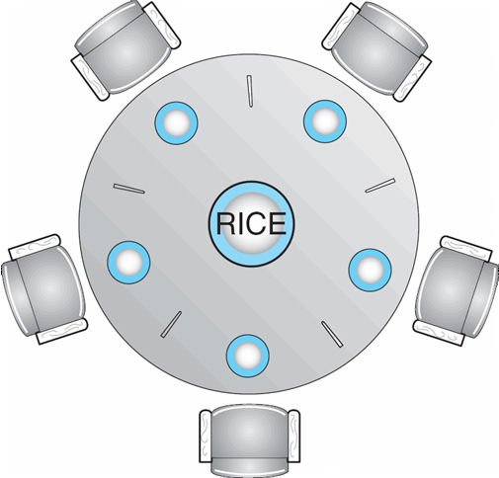
Dining-Philosophers Problem
Shared data
Bowl of rice (data set)
Semaphore chopstick [5] initialized to 1
55

Slide 62
Dining-Philosophers Problem (Cont.)
The structure of Philosopher i:
While (true) {
wait ( chopstick[i] );
wait ( chopStick[ (i + 1) % 5] );
// eat
signal ( chopstick[i] );
signal (chopstick[ (i + 1) % 5] );
// think
}
56

Slide 63
Problems with Semaphores
Incorrect use of semaphore operations:
signal (mutex) …. wait (mutex)
wait (mutex) … wait (mutex)
Omitting of wait (mutex) or signal (mutex) (or both)
57

Slide 64
Monitors
Monitor is a programming-language construct that provides equivalent functionality to that of semaphores and that is easier to control.
Implemented in a number of programming languages, including
Concurrent Pascal, Pascal-Plus,
Modula-2, Modula-3, and Java.
58

Slide 65
Main characteristics of Monitor
Like a Abstract Data Type (as studied in Data structure)
1. Local data variables are accessible only by monitor (private data member of a class in C++)
2. Process enters monitor by invoking one of its procedures (public member function of a class)
3. Only one process may be executing in monitor at a time
Shared data structure can be protected by placing it in a monitor
Access shared data only through monitor procedure => not scattered through codes (easier to verify)
59

Slide 66
Synchronization in Monitor
Monitor supports synchronisation by containing condition variables
only accessible by monitor.
Condition variable: a special data type in monitors, with two operations:
cwait(c): suspend calling process on condition c
Put calling process on a waiting queue associated with condition c
csignal(c): resume some process that was blocked after a cwait() operation on condition c
Wake up a process on waiting queue associated with condition c
60

Slide 67
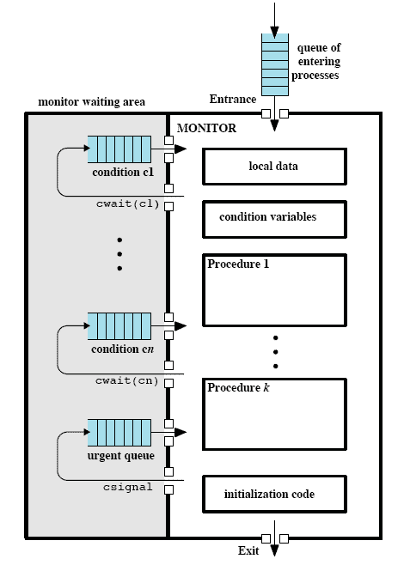
Illustration of a Monitor
Processes waiting for monitor availability.
A single entry point that is
guarded so that only
one process may be in
the monitor at a time.
a process in monitor
may block itself on
condition x by issuing
cwait(x) => enters
associated queue
a process in monitor detects
a change in condition
variable x, it issues csignal(x)
=> Alerts queue
61

Slide 68
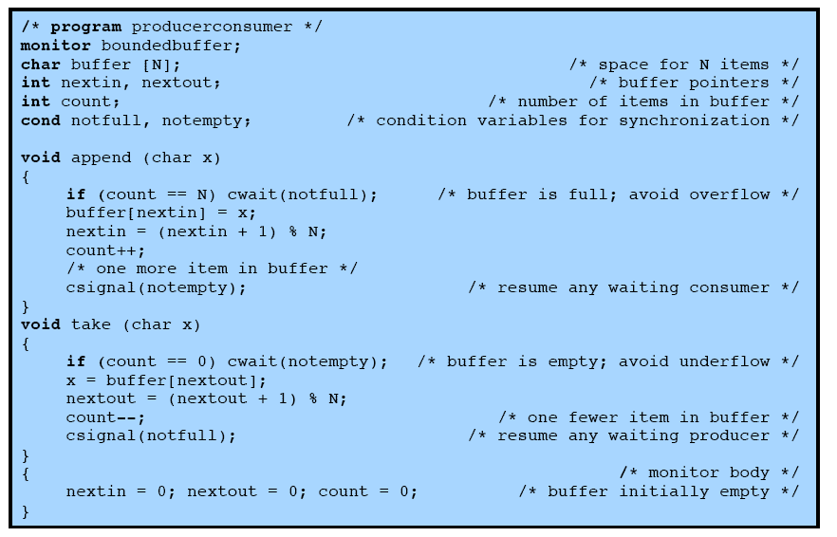
Bounded Buffer Solution: Monitor
62

Slide 69
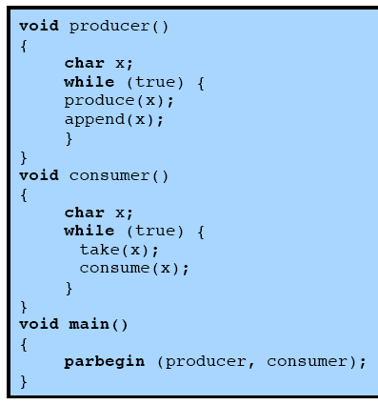
Producer, Consumer using Monitor
63

Slide 70
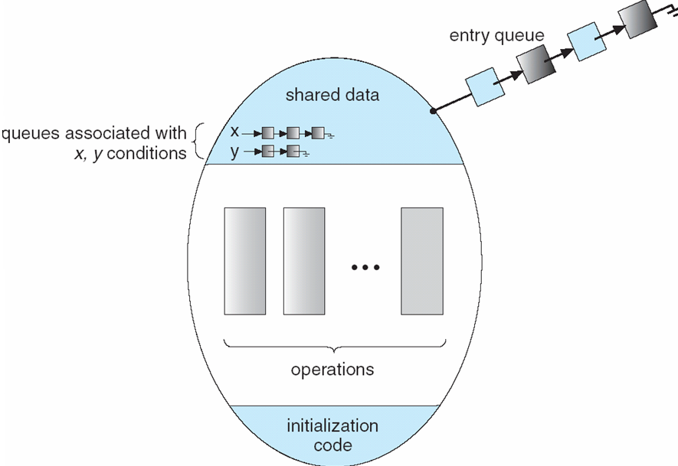
Monitor with Condition Variables
64

Slide 71
Solution to Dining Philosophers
monitor DP
{
enum { THINKING; HUNGRY, EATING) state [5] ;
condition self [5];
void pickup (int i) {
state[i] = HUNGRY;
test(i);
if (state[i] != EATING) self [i].wait;
}
void putdown (int i) {
state[i] = THINKING;
// test left and right neighbors
test((i + 4) % 5);
test((i + 1) % 5);
}
65

Slide 72
Solution to Dining Philosophers (cont)
void test (int i) {
if ( (state[(i + 4) % 5] != EATING) &&
(state[i] == HUNGRY) &&
(state[(i + 1) % 5] != EATING) ) {
state[i] = EATING ;
self[i].signal () ;
}
}
initialization_code() {
for (int i = 0; i < 5; i++)
state[i] = THINKING;
}
} // end of Monitor DP
66

Slide 73
Solution to Dining Philosophers using monitor
Each philosopher i invokes operations pickup()
and putdown() in the following sequence:
dp.pickup (i)
//EAT
dp.putdown (i)
67

Slide 74
Monitor Implementation using Semaphores
Variables
semaphore mutex; // (initially = 1)
semaphore next; // (initially = 0)
int next_count = 0; //# of processes waiting on next
Each procedure F will be replaced by
wait(mutex);
…
body of F;
…
if (next_count > 0)
signal(next)
else
signal(mutex);
Mutual exclusion within a monitor is ensured.
68

Slide 75
Monitor Implementation
For each condition variable x, we have:
semaphore x-sem; // (initially = 0)
int x-count = 0;
The operation x.wait can be implemented as:
x-count++;
if (next-count > 0)
signal(next);
else
signal(mutex);
wait(x-sem);
x-count--;
69

Slide 76
Monitor Implementation
The operation x.signal can be implemented as:
if (x-count > 0) {
next-count++;
signal(x-sem);
wait(next);
next-count--;
}
70

Slide 77
Synchronization Examples
Solaris
Windows XP
Linux
Pthreads
71

Slide 78
Linux Synchronization
Nonpreemptive kernel prior to Version 2.6.
Linux:
disables interrupts to implement short critical sections
Linux provides:
semaphores
spin locks
72

Slide 79
Pthreads Synchronization
Pthreads API is OS-independent
It provides:
mutex locks
condition variables
Non-portable extensions include:
read-write locks
spin locks

Slide 80
Not covered: Atomic Transactions
74

